Slide 1
Expressionism in 20th Century American Drama
Dr. Lakshmi Muthukumar,
Head, Dept. of English
Material for Semester 4
2019-20

Slide 2
1920s
Though realism was still considered a new style in early 20th century theatre, by the 1920s, American playwrights had begun to look beyond realistic surfaces toward their characters’ inward, often tortured lives.

Slide 3
Influenced and inspired by:
German playwrights and directors in the era just beyond the First World War
Driven by the same need to explore the human psyche found in painters such as Vincent Van Gogh and Edvard Munch
Theorists such as Carl Jung and Sigmund Freud
A German film The Cabinet of Dr. Caligari (1919) was also an influence

Slide 4
What is Expressionism?
Expressionism tried to convey inner psychological and emotional states through:
Boldly distorted sets
Stylized dialogue
Nightmarish distortions
Strange angles
Jarring sounds and staccato speech
Briskly episodic plots

Slide 5
Expressionism attempted to give voice to anxieties created by an increasing sense that life had become inhumanely fast, mechanized, and impersonal, dominated by the very technology that was supposed to liberate humanity.

Slide 6
Leading American dramatists who used Expressionism
Eugene O’Neill
Elmer Rice
John Howard Lawson
Sophie Treadwell

Slide 7
The Influence of German Playwrights
Walter Hasenclever
Ernst Toller
Georg Kaiser
These three German playwrights produced a body of plays between 1914 and 1922 that established expressionism not only as a bold theatrical style but also as a mode of political and cultural criticism.

Slide 8
The influence of August Strindberg
The origin of expressionism in theatre is usually traced to the later plays of the Swedish playwright August Strindberg, especially his radically non-realistic A Dream Play (1902) and The Ghost Sonata (1907).

Slide 9
The Dream in Expressionistic Plays
In Strindberg’s preface to The Ghost Sonata he explains: “the dream is a heightened reality in which a single consciousness is fractured, liberated from everyday realities and logic, but tormented by its own hidden anxieties”.
Expressionistic plays offered an alternative to the social realism of Ibsen and his admirers, appealing especially to those who wished to explore what Nietzche had called the Dionysian forces in art and life.

Slide 10
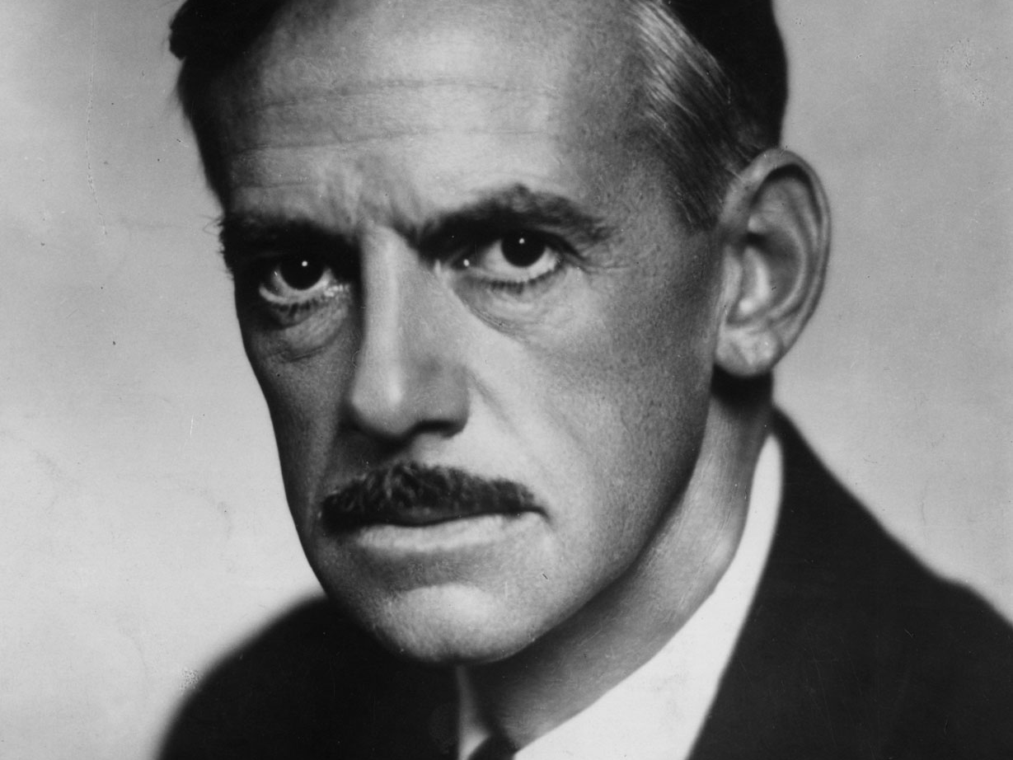
EUGENE O’NEILL (1888-1953)
The playwright who transformed American drama from an entertainment to a serious literary form

Slide 11
Seminal Expressionistic Plays by O’Neill
The Emperor Jones (1920)
The Hairy Ape (1922)
All God’s Chillun Got Wings (1924)
Desire Under the Elms (1924)
The Great God Brown (1926)
Days Without End (1933)
O’Neill also wrote the brief “Memoranda on Masks”- a key text in the theory of expressionistic staging in 1932.

Slide 12
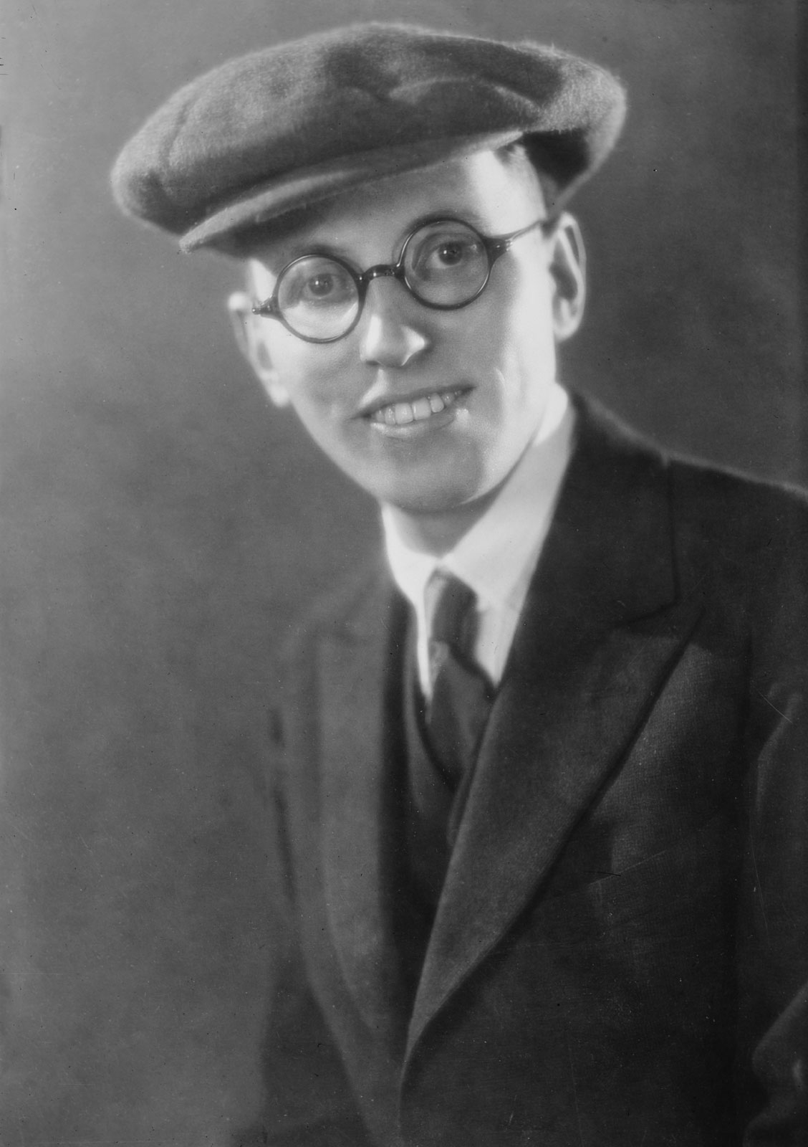
Elmer Rice
(born Reizenstein)
(1892-1967)
His first great success was the play On Trial (1914)
Another play which has been frequently anthologized is The Adding Machine (1921) An expressionistic satire on the dehumanization of “Mr. Zero” by technology.
The Subway (1929) mingled expressionism with naturalism
Street Scene (1929) his best play for which he was awarded the Pulitzer prize and See Naples and Die (1929) a good humoured farce

Slide 13

The Adding Machine- presented broader carricatures of modern life
Mr. Zero is a bookkeeper who is fired and this prompts him to murder his boss. Mr. Zero is first shown in a confining room lined with the foolscap sheets used in his trade, suggesting a life without joy or escape. A full range of visual, aural, and mechanical effects are deployed to convey the disorder of Mr. Zero’s psyche, including loud music, distorted scenery, swirling lights, and a spinning platform built into the office floor.

Slide 14
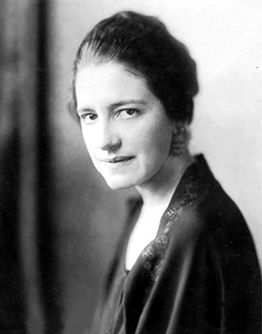
Sophie Treadwell
(1885-1970)
Plays:
Gringo (1922) based on her experiences in Mexico
O Nightingale (1925) a comedy about a stage-struck young woman
Machinal (1928) based on a sensational murder trial.
For Saxophone (1934) which heavily relied on music and dance and the voices of unseen characters to tell the story of another young woman trapped in a marriage of convenience
Plumes in the Dust (1936) based on the life of Edgar Allen Poe
Rights (1921) an unproduced drama on the life of 18th century feminist Mary Wollstonecraft
Ladies Leave (1929) a seriocomic look at a young woman’s attempt to enliven her marriage by taking a lover.
Hope for a Harvest (1941) exposes prejudice and environmental destruction in her native California.

Slide 15
Machinal
Written in the expressionistic style Machinal ,
tells the story of a sensitive young woman who desperately tries to find happiness in a mechanized, male-dominated world. The play featured flat, symbolic characters as well as repetitive dialogue and action.

